Slide 1
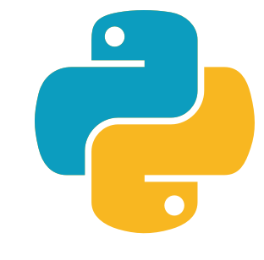
Python
- Nidhi Vaishnav

Slide 2
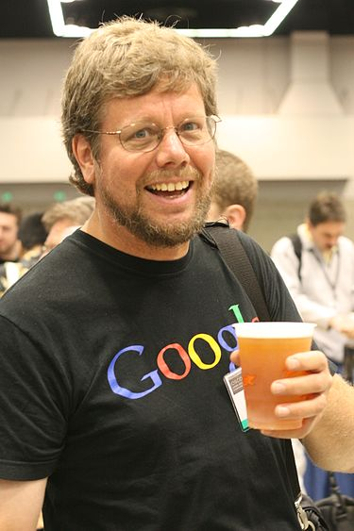
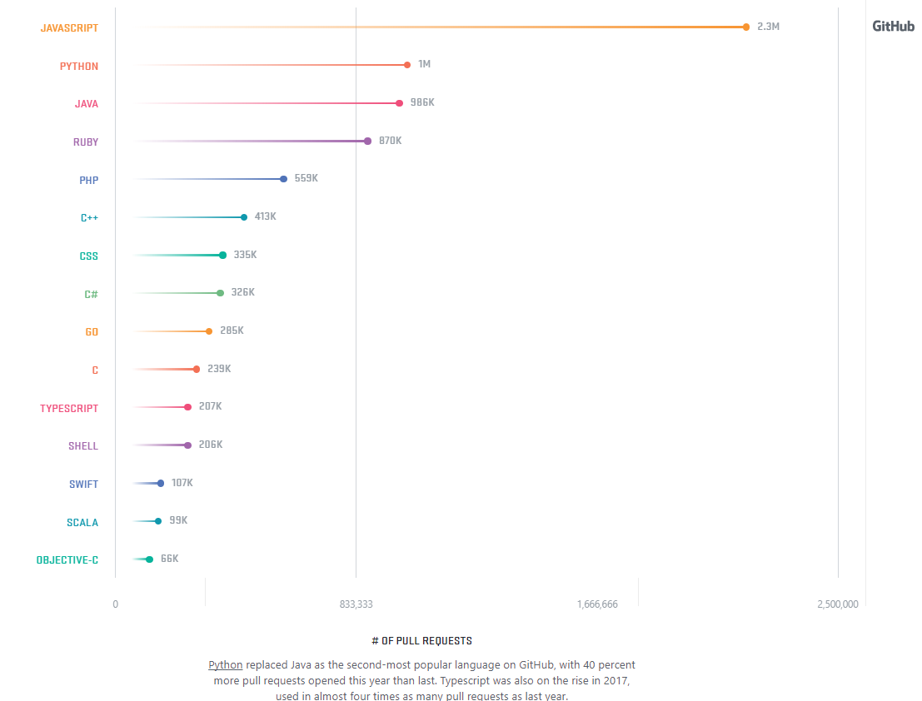
Introduction
Created by Guido van Rossum
(Benevolent Dictator For Life)
2nd most popular language on the GitHub in 2017

Slide 3

What is python?

Slide 4
Multi-purpose
software in a wide variety of application domains
Ex. Web, GUI, Scripting etc.
Strongly typed and dynamic speed
Focus on readability and productivity

Slide 5
Object Oriented
Works with objects and class
Abstraction
Show only relevant data
Encapsulation
Everyone knows how to access it.
can be easily used regardless of implementation details.
Inheritance
Acquiring properties of parents
Polymorphism
Based on certain implementation, perform action

Slide 6
Interpreted
Compiled vs Interpreted
Compiled Language: convert entire program into machine code in order to execute
Faster to execute
Interpreted: run through a program line by line and execute each command instead of converting it into machine code
Easy to code, test and change
Platform independence
Python: interpreted language
Supported by most IDE (Integrated Development Environment)
Ex. Eclipse, NetBeans, IntelliJ IDEA

Slide 7
Features
Everything is an object
Interactive shell
Strong introspection
Cross platform
Libraries like numpy, scipy, matplotlib, pandas, opencv, tensorflow

Slide 8
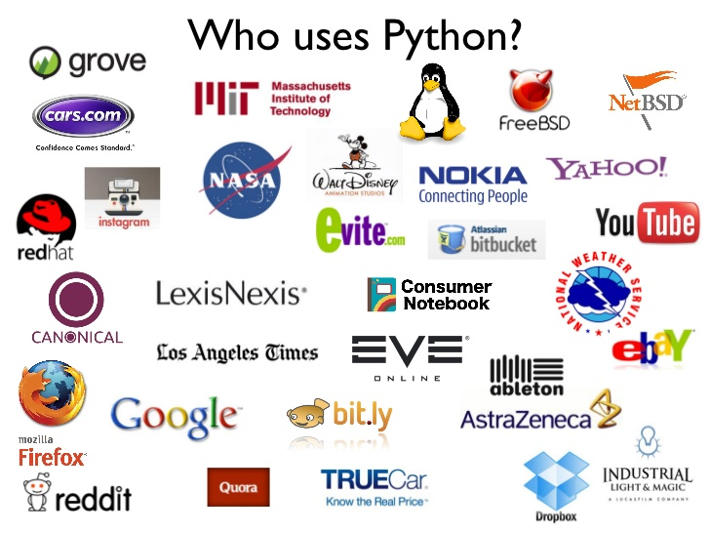

Slide 9
Core Philosophy of Python
Beautiful is better than ugly
Write programs for human readers
Consistent sentence and behavior
Readability counts
Easy to understand
Well-indented code
Minimal punctuation
Sparse is better than dense
Don't try to stick too much code on one line

Slide 10
Core Philosophy of Python
Explicit is better than implicit
Always mention the module whose method you are working with
Use of self inside methods to understand which object you are working with
Simple is better than complex
Print statement
Interactive interpreter for experiments

Slide 11
